Slide 1

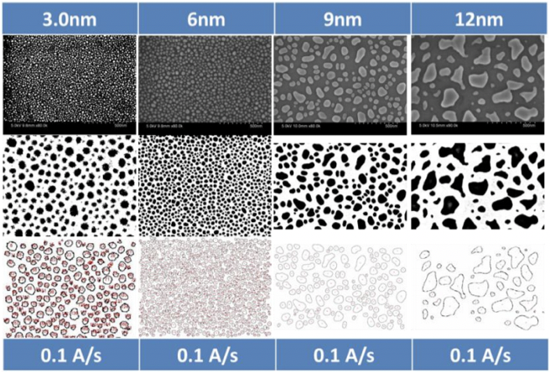
AI Image Analysis for Nanotechnology ——Presentation II
Advisor Prof Huan Hu
Prof Mark D.Butala
Student Jieting Chen
Yiqun Niu
Yue Feng

Slide 2
1
Result from Last Demo
Notes:
Last time, we give up the binary method (This kind of transition just ignore the bottom particle and give a clear boundary for the above particles
) and then we choose to adjust the HSV of the image by hands to get the better result (HSV is better than RGB and GRAY for clearer ). Though we can use “sharpen” option
in ImageJ to make the edge more obvious, the problem is where is the “edge” that we really want, which is explained in the next slide.

Slide 3
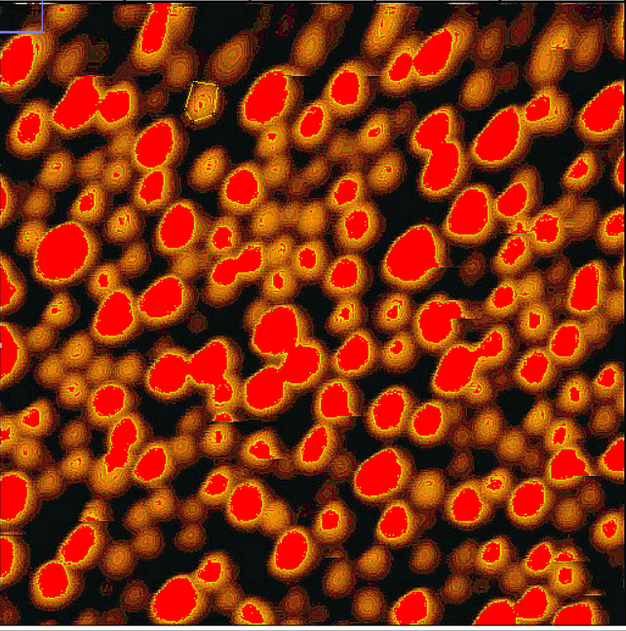
Notes:
As we can see, the ”edge” is just in the middle of transition from high hue to low hue. 可以说edge是渐变的,edge到底停在哪里，完全由我们用ImageJ预处理时选择的hue范围决定，
主要原因是扫描出来的图对比度不够强，峰值是一个范围（可以看下一张slide）

Slide 4
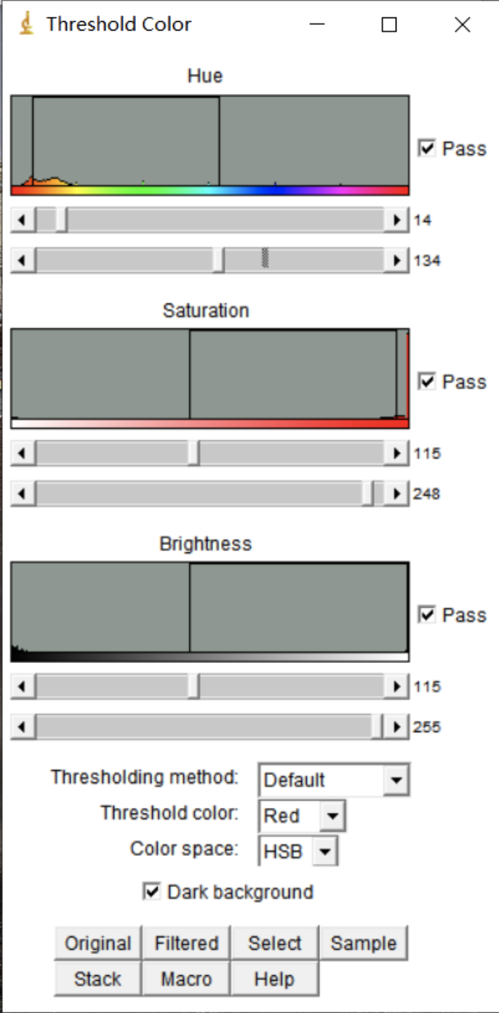
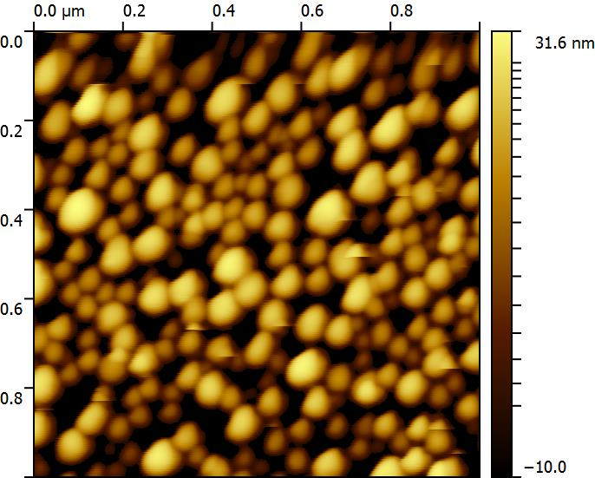
HSV Adjustment by Ourselves
Problem:
1. Cannot judge the edge accurately.
2. Ignore the bottom particles.
Notes:
In more detail, 在右边那个窗口图里，我们可以看到Hue那个指数（箭头所指），色域是一段范围而不是一个特定的峰值，所以我们很难判断真正的edge.

Slide 5
2
Better Result
Notes:
Last time, we give up the binary method (This kind of transition just ignore the bottom particle and give a clear boundary for the above particles
) and then we choose to adjust the HSV of the image by hands to get the better result (HSV is better than RGB and GRAY for clearer ). Though we can use “sharpen” option
in ImageJ to make the edge more obvious, the problem is where is the “edge” that we really want, which is explained in the next slide.

Slide 6
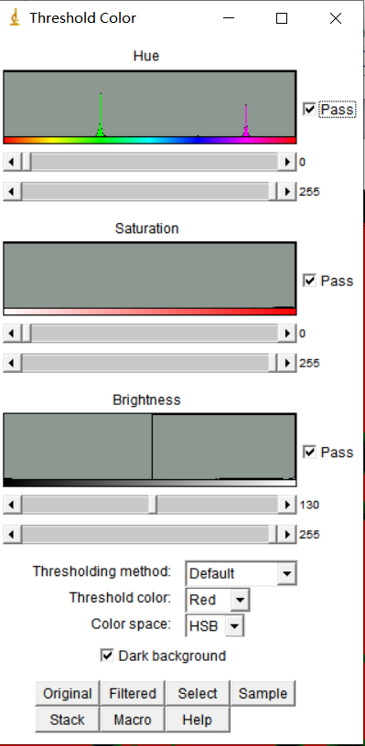
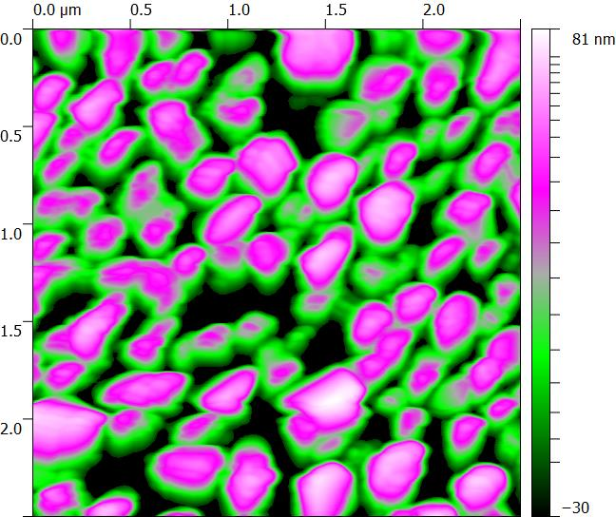
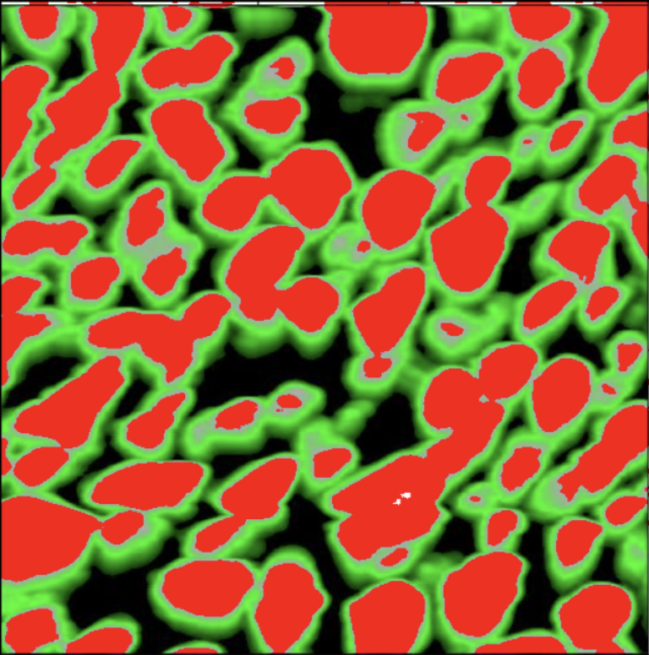
Improve the Contrast
During the AFM scanning process:
choose the colors which has the largest contrast.
Raise the value of ”down” in limit range.
Notes:
During the AFM scanning process, we can choose the colors which has the largest contrast and raise the value of “down”
in limit range to improve the result. The left image is what we get from the AFM.
Now, we can see 色域已经是两个特定的峰值（左上图箭头所指），扫描结果的contrast提高了，我们可以更好地判断出边缘然后进行进一步处理。
以上是通过优化扫描途径来得到更好的结果（better scanning measurement and preprocessing）
（保留问题：但是这样得出来的edge好像也不是真正的edge？那些绿色是不是也应该算在里边）
上次提到的python::opencv simpleBlobDetector 和 filter仍在研究中（下面那张slide可删因为我们还没做出来，笑哭.jpg）

Slide 7
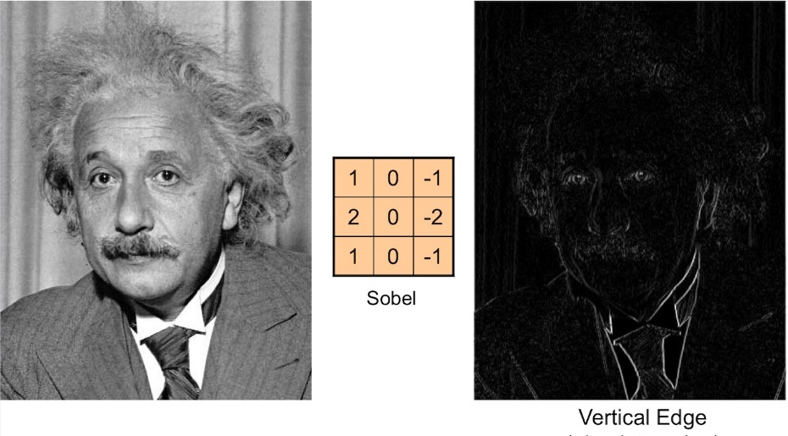
New Method——Python Opencv
Method 1
SimpleBlobDetector: According color area circularity inertia convexity to select the figures.
Method 2
Filter: Select where the color changes rapidly.

Slide 8
3
Results Analysis
Notes:
Last time, we give up the binary method (This kind of transition just ignore the bottom particle and give a clear boundary for the above particles
) and then we choose to adjust the HSV of the image by hands to get the better result (HSV is better than RGB and GRAY for clearer ). Though we can use “sharpen” option
in ImageJ to make the edge more obvious, the problem is where is the “edge” that we really want, which is explained in the next slide.

Slide 9
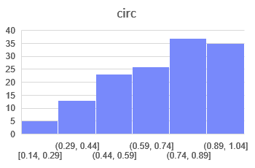
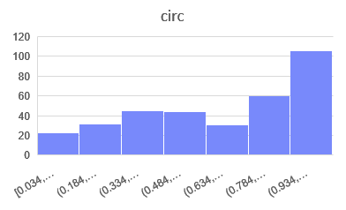
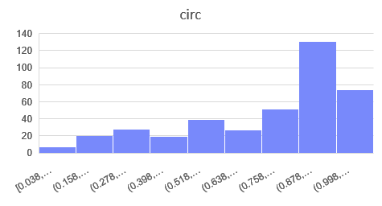
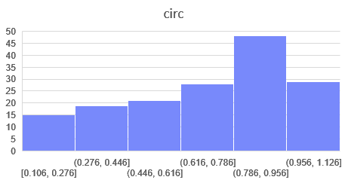
Temperature: org 25
10nm
Circ.
Temperature: 240 360

Slide 10
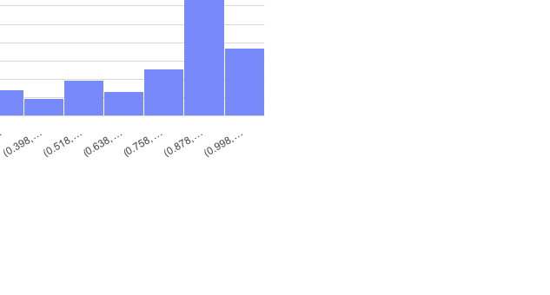
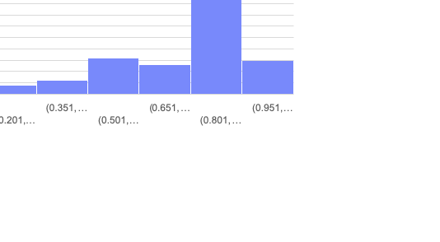
Temperature: 480 25
10nm
Circ.
Temperature: 240 360

Slide 11
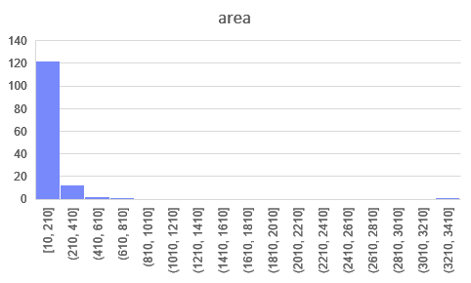
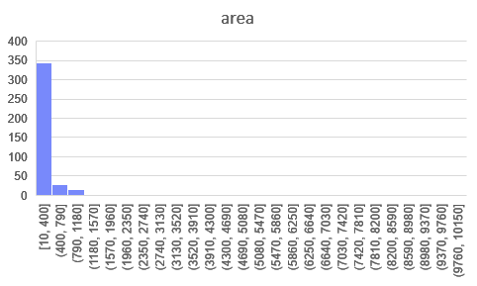
Temperature: ori
10nm
Area
Temperature: 25

Slide 12
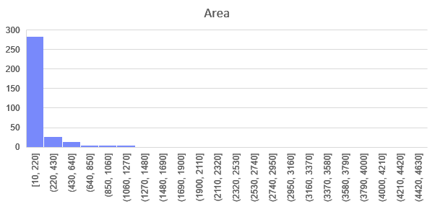
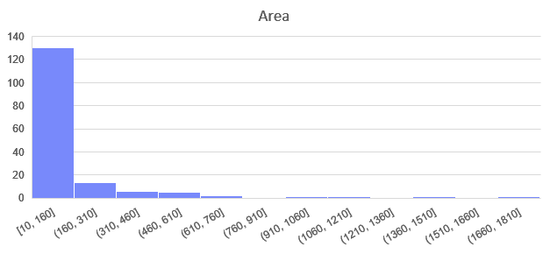
Temperature: 240
10nm
Area
Temperature: 360

Slide 13
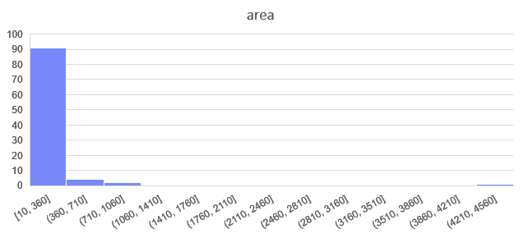
Temperature: 480
10nm
Area
Temperature: 360

Slide 14
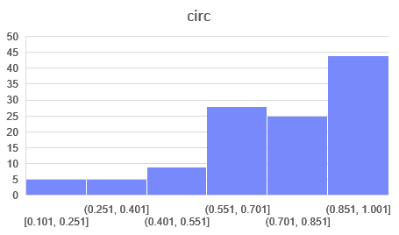
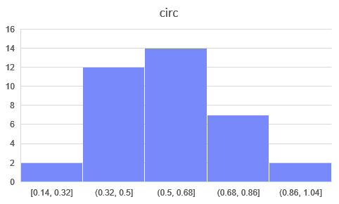
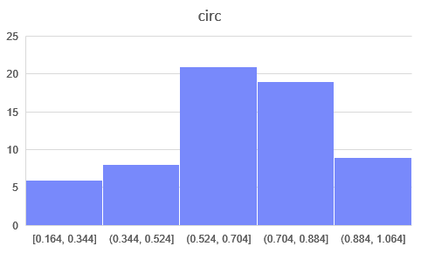
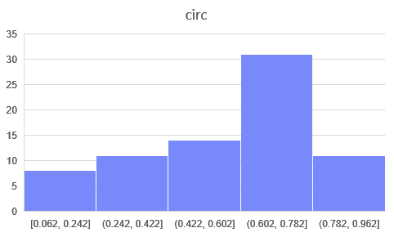
Temperature: ori 25
20nm
Circ.
Temperature: 240 360

Slide 15
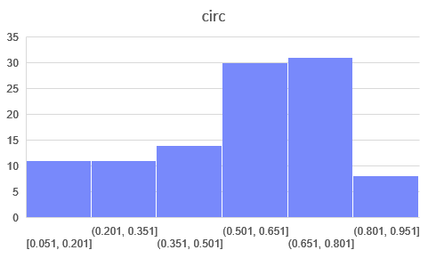
Temperature: 480 25
20nm
Circ.
Temperature: 240 360

Slide 16
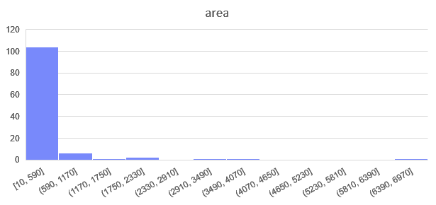
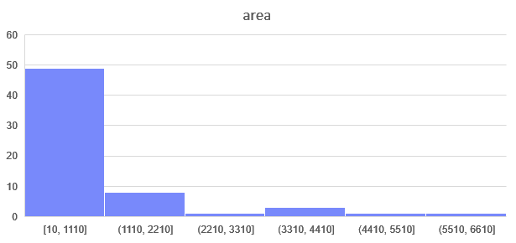
Temperature: ori
10nm
Area
Temperature: 25

Slide 17
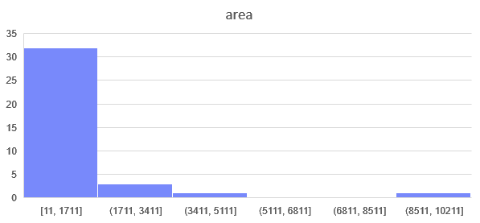
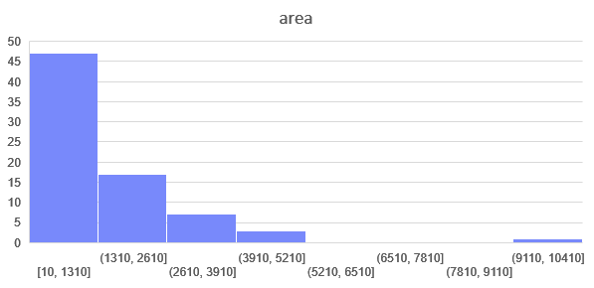
Temperature: 240
10nm
Area
Temperature: 360

Slide 18
Temperature: ori 25
10nm
Circ.
Temperature: 240 360

Slide 19
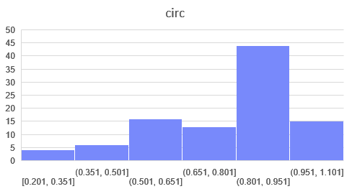
Temperature: 480 25
10nm
Circ.
Temperature: 240 360

Slide 20
Temperature: ori
10nm
Area
Temperature: 25

Slide 21
Temperature: 240
10nm
Area
Temperature: 360

Slide 22
Temperature: 480
10nm
Area
Temperature: 360

Slide 23
Temperature: ori 25
20nm
Circ.
Temperature: 240 360

Slide 24
Temperature: 480 25
20nm
Circ.
Temperature: 240 360

Slide 25
Temperature: ori
10nm
Area
Temperature: 25

Slide 26
Temperature: 240
10nm
Area
Temperature: 360

Slide 27
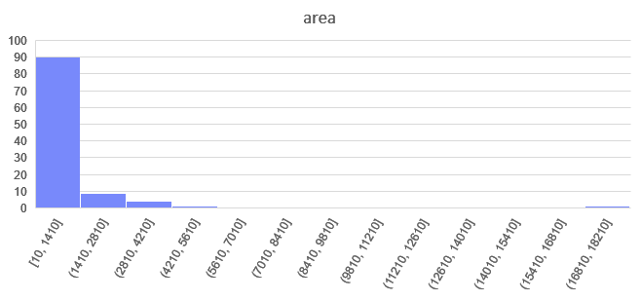
Temperature: 480
10nm
Area
Temperature: 360

Slide 28
Temperature: 480
10nm
Area
Temperature: 360

